Slide 1
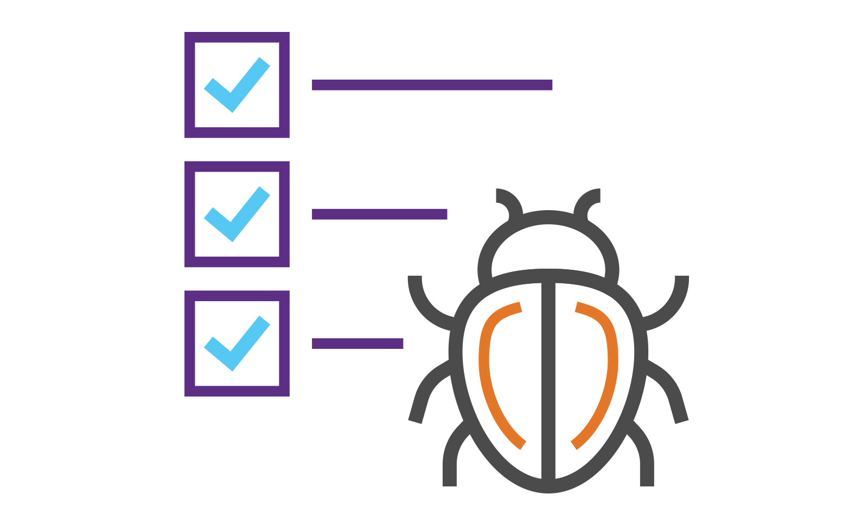
Standards to follow during development cycle.
Think twice code once

Slide 2
These all points relate with Android application development.
Whenever you create any project always create product flavour.
Define gradle dependencies variable into single place.
Enable progourd and shrink resources while publishing application.
Always define constants and common function in separate files.
Use inheritance if some common behavior found in different class.
Comment and naming convention.
Break your code into modules.
Learn code separation.
Learn debugging and know how to right down test cases.

Slide 3
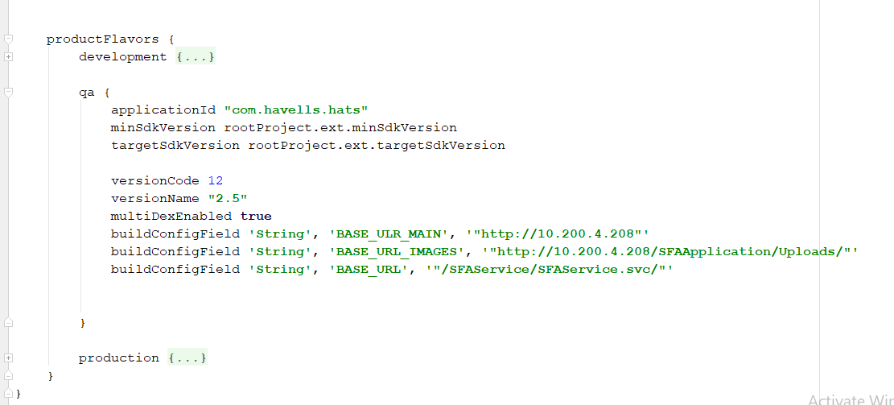

Slide 4
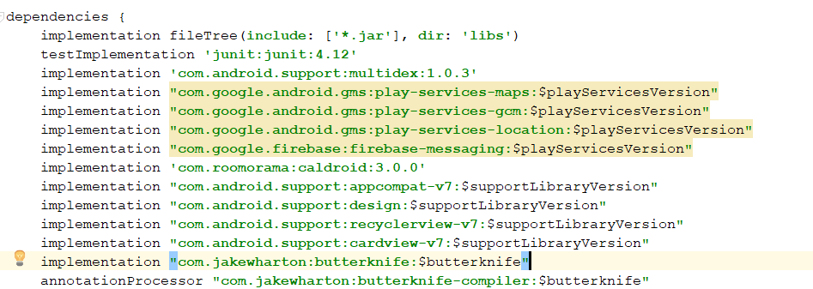

Slide 5
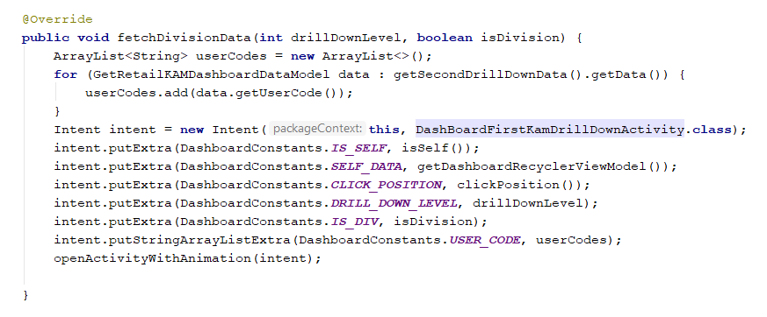

Slide 6

Application Development Process

Slide 7
You are a part of a team which is managed by project manager and account manager.
Firstly all the business requirement is written in BRD (Business Requirements Document)
After that a FRS (functional requirement specification) and mockup will be created.
After that a common repository created whose access is provided to each team member.
Now task is divided into sprint or say phases.
You have a task sheet to be filled to record your daily hour utilized in project.

Slide 8
After that each task done by team member is committed to that repository.
After successfully building it is passed to testing team.
Than tester write down the test cases which are not fulfilled.
This process repeat until all test cases passes.
If production is deployed than its master is created.
If changes required in production you need to write down CR( Change Request)
If new request is added then you have to raise SR (Service Request)
If there is issue in production faced by user then there incident raise

Slide 9
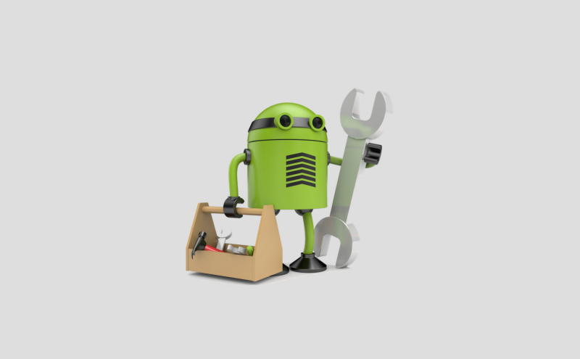
Some useful website for development

Slide 10
Android developer site https://developer.android.com/develop/index.html.
Github url to access mostly used ui widget https://github.com/wasabeef/awesome-android-ui .
Website which have everything pre developed https://android-arsenal.com/
Useful resource for Android development https://guides.codepath.com/android
All the public API required for development https://github.com/toddmotto/public-apis

Slide 11
To download icons https://www.flaticon.com/, https://icons8.com/
Convert JSON schema to pojo http://www.jsonschema2pojo.org/
JSON formatter http://jsonviewer.stack.hu/
Rest Client https://www.getpostman.com/
Check Gradle Version http://gradleplease.appspot.com/
9patch image generator https://romannurik.github.io/AndroidAssetStudio/nine-patches.html#&sourceDensity=320&name=example

Slide 12


Slide 13
Some Useful library used in Android
Butterknife | Dragger | RxJava
LiveData | ViewModel | Room
Picasso | Glide | EventBus
FirebaseJobDispatcher | Realm | Retrofit
OkHttpClient | Zxing | Timber
Leak Canary

Slide 14

Introduction

Slide 15
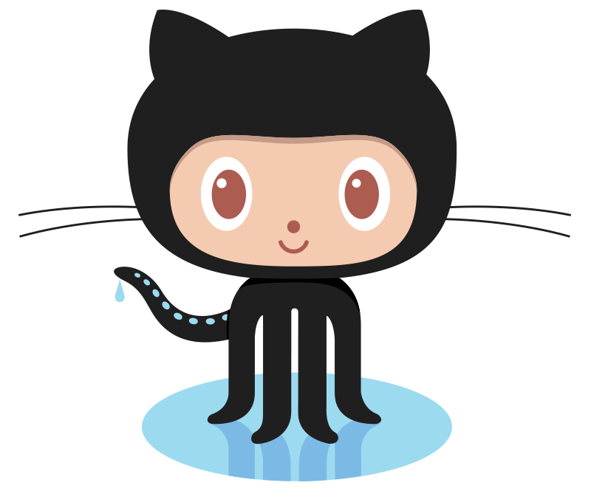
GIT + HUB
A Command Line Tool
A common platform
GitHub is a code hosting platform for version control and collaboration. It lets you and others work together on projects from anywhere.
https://github.com/

Slide 16
Git Terminology
Push
Pull
Merge
Commit
Branch
Fork
Master

Slide 17
Get Started
1) Install Git in your system. Depending on OS from Url https://git-scm.com/downloads.
2) After installing Git open browser and type https://github.com/ and create your account.
3) Create a Github repository.
4)After creating account move to android studio press CLT+ALT+S or open setting expand version control and fill login details.
5) After filling login details add Git path under version Control in toolbar select VCS and press enable version control and select GIT in popup window.

Slide 18
6) Now right click on your project there is menu item name Git just click on it than on further popup press add. After that press commit.
7) In new Pop up set commit message and after that press commit and push.
8) Now in new window select define remote and add Github repository Url.
9) If everything is OK select push.

